Slide 1

PostgreSQL: Basic

Slide 2
Overview​
​Welcome to this comprehensive overview of PostgreSQL and how to use it with pgAdmin. Discover the amazing features and learn how to set up and manage databases with ease. we will explore the importance of PostgreSQL, dive into its key features, and learn how to perform basic SQL operations using pgAdmin.
Notes:
2

Slide 3
What is PostgreSQL?
PostgreSQL (Postgres) is a powerful, free, open-source object-relational database system known for its reliability, flexibility, and advanced features, supporting both SQL (relational) and JSON (non-relational) data, used widely for web, mobile, geospatial, and analytical applications. It's highly compliant with standards, offers robust transaction support (ACID), and runs on most operating systems, making it a popular choice for everything from small projects to large data warehouses.
Notes:
3

Slide 4
Features of PostgreSQL
Open Source
Free to use, with a strong community backing.
Relational Database
PostgreSQL offers full support for tables, relationships, and SQL queries, making it ideal for managing structured data.​
Extensibility​
With support for custom data types, functions, and extensions, PostgreSQL allows developers to tailor the database to their specific needs.​
Data Integrity​
PostgreSQL ensures data integrity with features such as constraints, triggers, and transactions, ensuring reliable and accurate data.​
Cross-Platform
Works on Windows, Linux, macOS, and more.
Notes:
4

Slide 5
How to install & set up?
Download the PostgreSQL installer from the official website.​
Run the installer and follow the on-screen instructions to complete the installation.
Configure the installation settings, including the database superuser password and port number.
Start the PostgreSQL service and verify the successful installation.
Ref. Link
https://www.postgresql.org/download/
https://www.postgresqltutorial.com/postgresql-getting-started/install-postgresql/
Notes:
5

Slide 6
Introduction to pgAdmin
pgAdmin is the leading open-source management tool for PostgreSQL, the world's most advanced open-source database. pgAdmin 4 is designed to meet the needs of both novice and experienced Postgres users alike, providing a powerful graphical interface that simplifies the creation, maintenance, and use of database objects.
Notes:
6

Slide 7
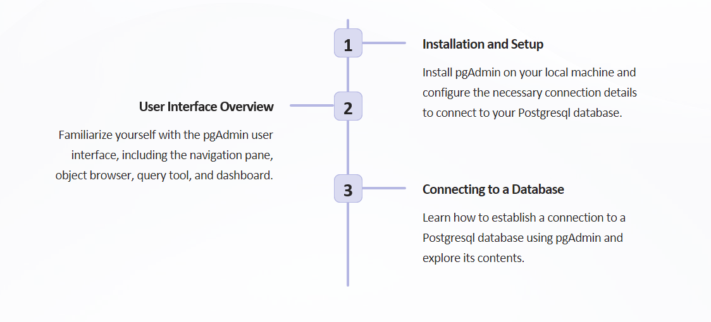
Getting Started with pgAdmin
Notes:
7

Slide 8
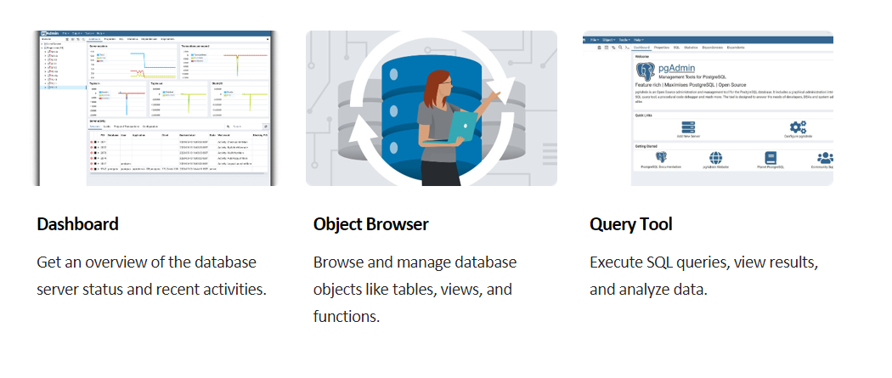
Navigating pgAdmin
Notes:
8

Slide 9
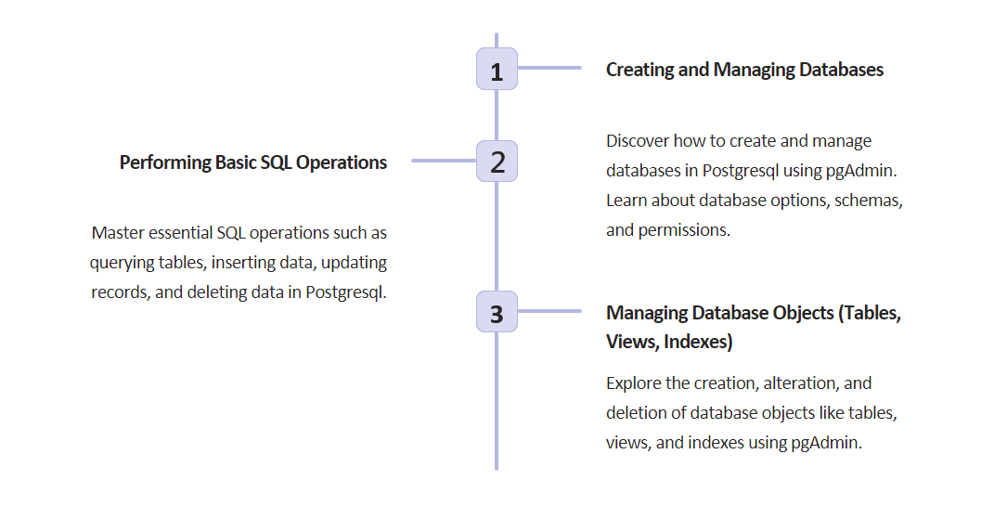
Working with Postgresql and pgAdmin
Notes:
9

Slide 10
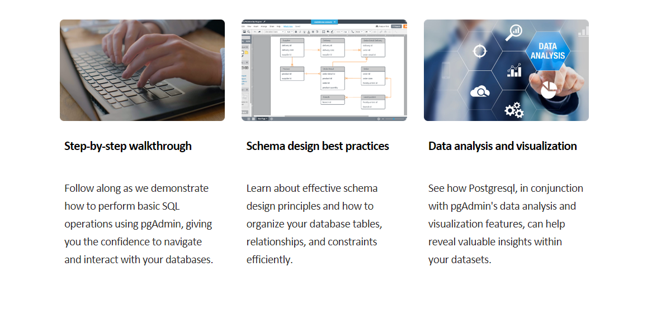
Hands-on demo with pgAdmin
Notes:
10

Slide 11
How to Create Database
How to use the PostgreSQL CREATE DATABASE statement to create new databases in the PostgreSQL database server.
Using Query
CREATE DATABASE database_name
Using pgAdmin
The pgAdmin tool provides you with an intuitive interface for creating a new database. First, log in to the PostgreSQL database server using pgAdmin.
Second, right-click the Databases node and select Create > Database… menu item
Notes:
11

Slide 12
How to Create Schema
In PostgreSQL, a schema is essentially a namespace that contains various database objects. Each schema provides a way to group related objects together, making the database more organized and easier to manage. For example, we can use separate schemas for different application modules, like sales, inventory, and hr.
Using Query
CREATE SCHEMA schema_name;
Using pgAdmin
Open pgAdmin and connect to your PostgreSQL server
Expand the specific database in which you want to create the new schema.
Right-click on the Schemas node under that database.
Select Create > Schema from the context menu.
A "Create - Schema" dialog box will appear.
Notes:
12

Slide 13
How to Table Schema
In PostgreSQL, the CREATE TABLE statement is used to define a new table within a database. It allows us to specify the table's structure, including column names, data types, and constraints, ensuring data integrity and consistency. Understanding the PostgreSQL table creation process is essential for managing structured data.
CREATE TABLE table_name (
column_name TYPE column_constraint,
table_constraint table_constraint
) INHERITS existing_table_name;
Query
Optional Clauses:
IF NOT EXISTS: Ensures the table is created only if it doesn't already exist in the schema.
INHERITS: Allows a table to inherit columns from an existing table.
Notes:
13

Slide 14
PostgreSQL Data Types
PostgreSQL data types including Boolean, character, numeric, array, json, uuid, and special types.
Boolean for storing true and false value
Character types such as char, varchar, and text.
Numeric types such as integer and floating-point number. Z
UUID for storing Universally Unique Identifiers
Array for storing array strings, numbers, etc.
JSON stores JSON data
Binary allowing you to store byte arrays for applications that need to manage non-text data, such as images, audio, and other multimedia files.
Date/Time require accurate time tracking, such as event scheduling, logging, and historical data analysis.
Enumerated useful for situations where a column must contain one of a limited set of predefined values enhancing data integrity and readability.
Monetary A fixed-point type used for storing currency values.
Geometric ideal for applications involving spatial data, such as geographic information systems (GIS), computer graphics, and geometric modeling.
Notes:
14

Slide 15
PostgreSQL NULL vs NOT NULL
NULLNULL
NULL
Represents unknown or missing value
NOT equal to anything (even another NULL)
Syntax: email VARCHAR(150) NULL
NULLNULL
NULL
Value is mandatory
Syntax: name VARCHAR(100) NOT NULL
Where Condition to fetch records:
WHERE email IS NULL
WHERE email IS NOT NULL
Notes:
15

Slide 16
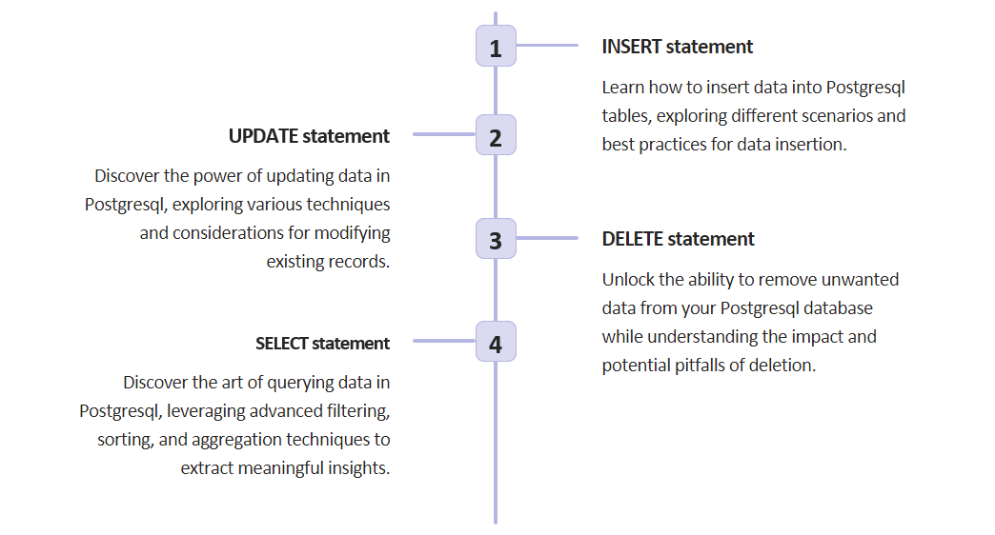
PostgreSQL Performing Basic Operations
Notes:
16

Slide 17
PostgreSQL Querying Data
Select
Column aliases – Assign temporary names to columns or expressions in a query. (select lastname AS surname)
Order By – Sort the result set returned from a query.
Select Distinct – Removes duplicate rows in the result set.
Notes:
17

Slide 18



Operators in the WHERE clause
We can operate with different operators in the WHERE clause:
Equal To: The = operator is used when you want to return all records where a column is equal to a specified value:
Less Than: The < operator is used when you want to return all records where a column is less than a specified value.
Greater Than: The > operator is used when you want to return all records where a columns is greater than a specified value.
Notes:
18

Slide 19




Operators in the WHERE clause
Less Than or Equal To: The <= operator is used when you want to return all records where a column is less than, or equal to, a specified value.
Greater Than or Equal to: The >= operator is used when you want to return all records where a columns is greater than, or equal to, a specified value.
Not Equal To: The <> operator is used when you want to return all records where a column is NOT equal to a specified value:
Notes:
19

Slide 20



Operators in the WHERE clause
LIKE: The LIKE operator is used when you want to return all records where a column is equal to a specified pattern.
  The pattern can be an absolute value like 'ANYTHING', or with a wildcard that has a special meaning.
  There are two wildcards often used in conjunction with the LIKE operator:
    The percent sign %, represents zero, one, or multiple characters.
    The underscore sign _, represents one single character.
ILIKE: Same as the LIKE operator, but ILIKE is case insensitive.
Notes:
20

Slide 21



Operators in the WHERE clause
AND: The logical AND operator is used when you want to check more that one condition:
OR: The logical OR operator is used when you can accept that only one of many conditions is true:
NOT: The NOT operator can be used together with LIKE, ILIKE, IN, BETWEEN, and NULL operators to reverse the truth of the operator.
Notes:
21

Slide 22



Operators in the WHERE clause
IN: The IN operator is used when a column's value matches any of the values in a list:
BETWEEN: The BETWEEN operator is used to check if a column's value is between a specified range of values:
IS NULL: The IS NULL operator is used to check if a column's value is NULL:
Notes:
22

Slide 23
PostgreSQL Sub Query
Subquery – write a query nested inside another query.
ANY – ANY means that the condition will be true if the operation is true for any of the values in the range.
  returns a Boolean value as a result
  returns TRUE if ANY of the sub query values meet the condition
ALL – ALL means that the condition will be true only if the operation is true for all values in the range.
  returns a Boolean value as a result
  returns TRUE if ALL of the sub query values meet the condition
  is used with SELECT, WHERE and HAVING statements
EXISTS –The EXISTS operator is used to test for the existence of any record in a sub query. The EXISTS operator returns TRUE if the sub query returns one or more records.
Notes:
23

Slide 24


PostgreSQL ORDER BY
ORDER BY
  The ORDER BY keyword is used to sort the result in ascending or descending order.
  The ORDER BY keyword sorts the records in ascending order by default. To sort the records in descending order, use the DESC keyword.
Notes:
24

Slide 25
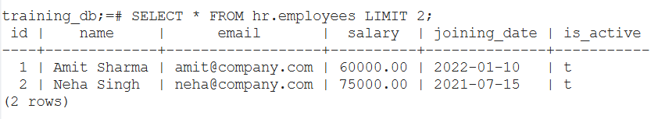
PostgreSQL LIMIT Clause
LIMIT Clause
  The Limit clause is used to return a limited number of records by the select statement, in other words the number of rows returned by the SQL statement. The basic Syntax is:
  SELECT col1,col2,...,colN
  FROM table_name
  LIMIT [number of rows]
Notes:
25

Slide 26
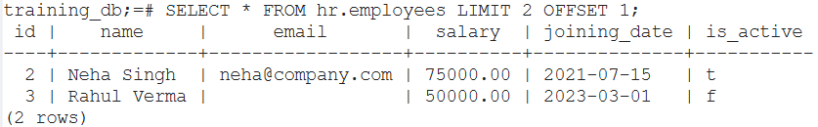
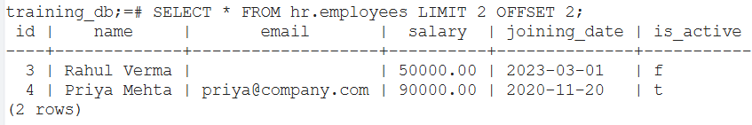
PostgreSQL LIMIT With OFFSET Keyword
LIMIT with OFFSET Keyword
  The OFFSET keyword is used to jump a certain number of rows from the 1st row till 'Nth' row before beginning to return rows. The basic syntax is:
  select * from employees LIMIT N OFFSET N
Notes:
26

Slide 27
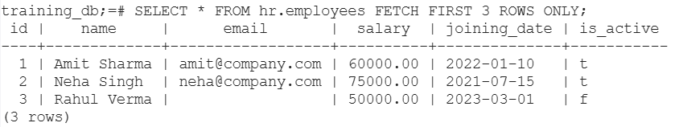
PostgreSQL FETCH Clause
FETCH Clause
  The FETCH clause works similar to the LIMIT clause which is to retrieve a subset of rows from a table. The basic syntax is:
  SELECT * FROM table_name FETCH [ FIRST | NEXT ] number_of_rows [ ROW | ROWS ] ONLY;
  SELECT columns FROM table_name ORDER BY column_name
  OFFSET offset_value ROWS FETCH NEXT page_size ROWS ONLY;
Notes:
27

Slide 28
THANK YOU
ANY QUESTIONS ?
Notes:
28

